Slide 1
Your Trusted Partner in Accreditation
Admin Guide for Revamped Website – Edit or Create a subpage (leftnav-page)
Sharon
AAD
24th June 2019
www.sac-accreditation.gov.sg

Slide 2

SAC Main Navigation Banner
Subpages are the inner pages under each of the links in the main navigation banner

Slide 3
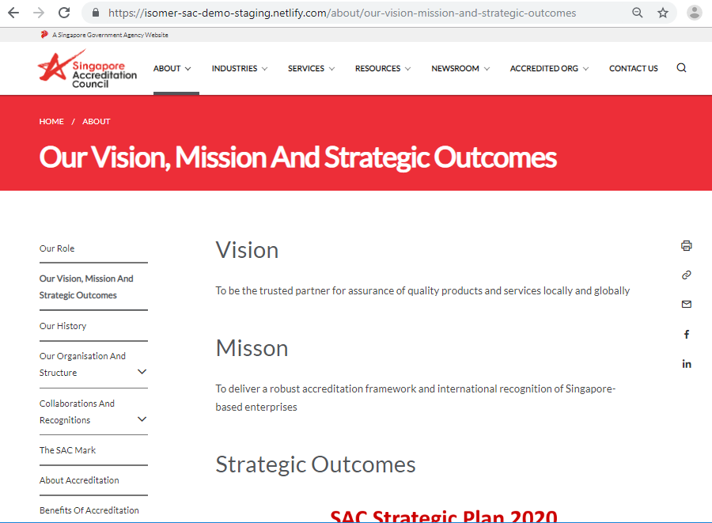
Example of a leftnav subpage
Permalink
Breadcrumb
Title
Left navigation bar (contains all the sub-pages under ‘About’)

Slide 4
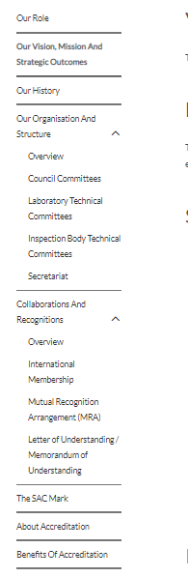
Example of a leftnav bar
2nd level navigation links
Titles for the 3rd level navigation links
3rd level navigations will not appear in the links in the main navigation menu bar (i.e. At the top of the website). They will only appear in the left-navigation bar of the subpages.
3rd level navigation links (collapsible by default in left navigation bar)

Slide 5
Example of a leftnav subpage
The leftnav-page template is used for most of the pages in the SAC website.
Other pages such as the Homepage, post pages inside NewsRoom, as well as some customised pages (‘Our Organisation and Structure’, ‘Certified Companies’, ‘FAQ’) do not use the template.
They will be covered in their respective guides.

Slide 6
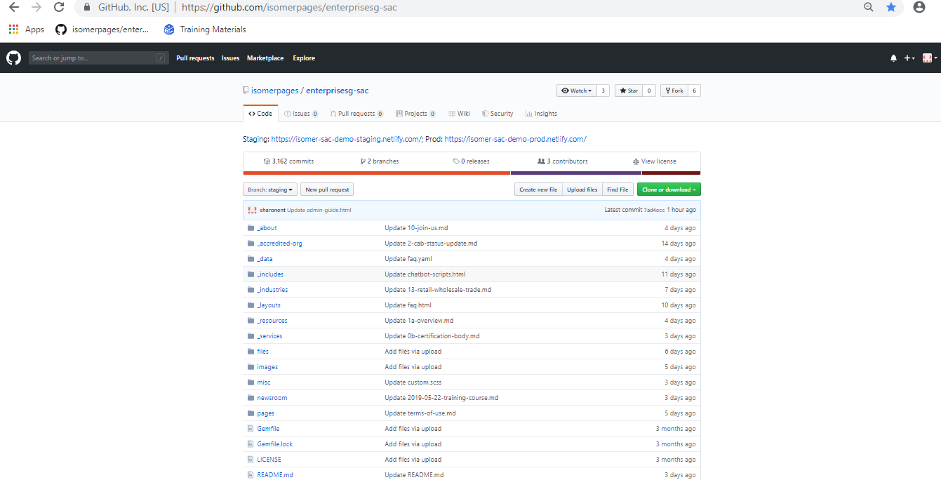
Editing inside Github Repository
1. Click on the folder corresponding to the main navigation link that contains the file which you wish to edit
E.g. If you wish to edit ‘Our Mission, Vision & Strategic Outcomes’ page, which is under the ‘About’ navigation section, you have to first choose the ‘_about’ folder in Github repository
Make sure to set to ‘Staging’ branch first

Slide 7
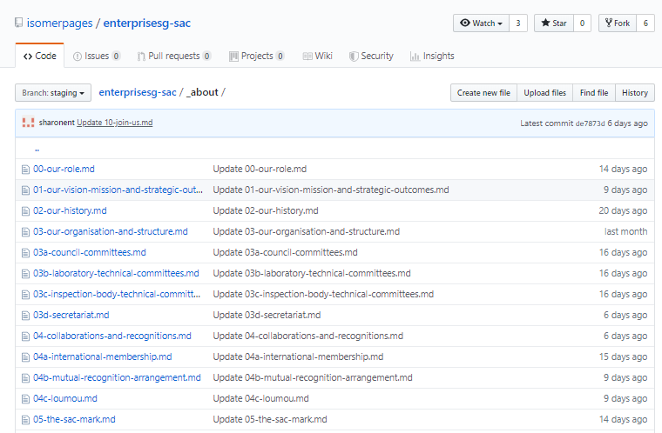
Editing inside Github Repository
2. Inside the selected folder, select the file that you wish to edit.
Leftnav pages are arranged in numerical order in the folder

Slide 8
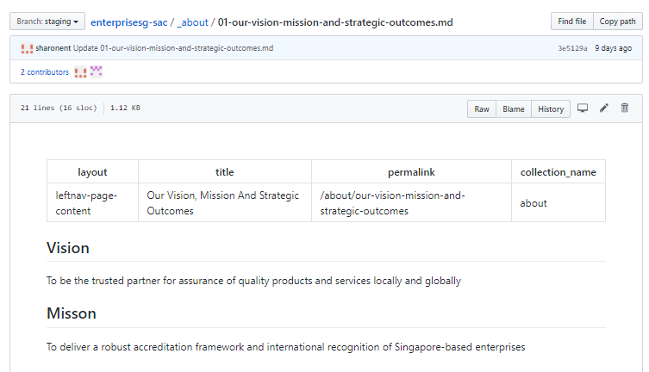
Editing inside Github Repository
3.Click on ‘Edit’ (pencil icon) button.
‘Edit’pencil icon is found on the top right hand corner of your file editor

Slide 9
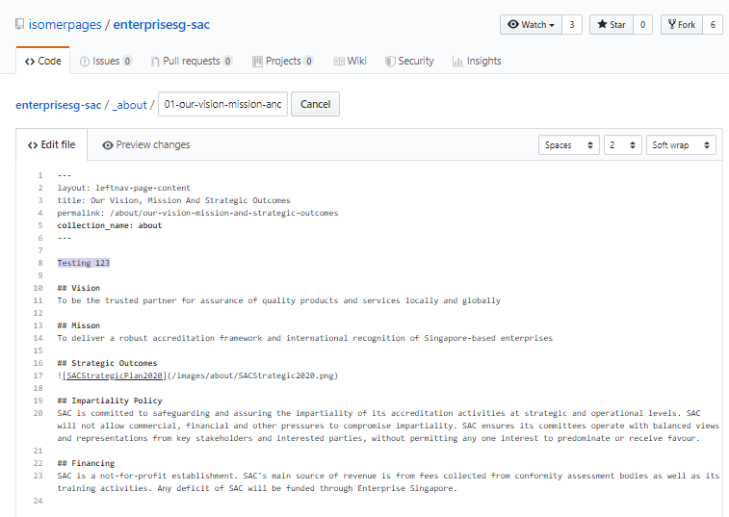
Editing inside Github Repository
4. Edit the Markdown content inside the text editor of the selected file.
Edited content

Slide 10
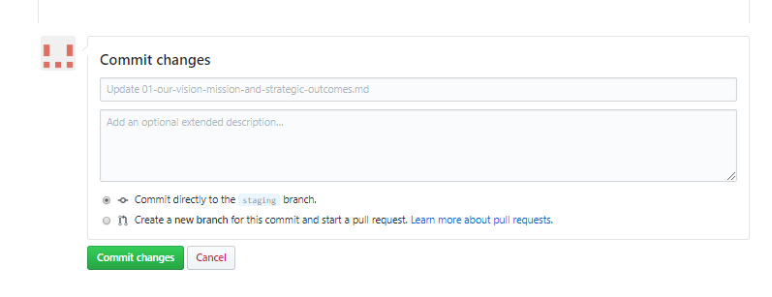
Editing inside Github Repository
5. Click on ‘Commit changes’ button at the bottom of the text editor.

Slide 11

Editing inside Github Repository
6. Wait a few minutes and refresh the website to view the edited page.
Edited content
Done! You have edited the page successfully!

Slide 12
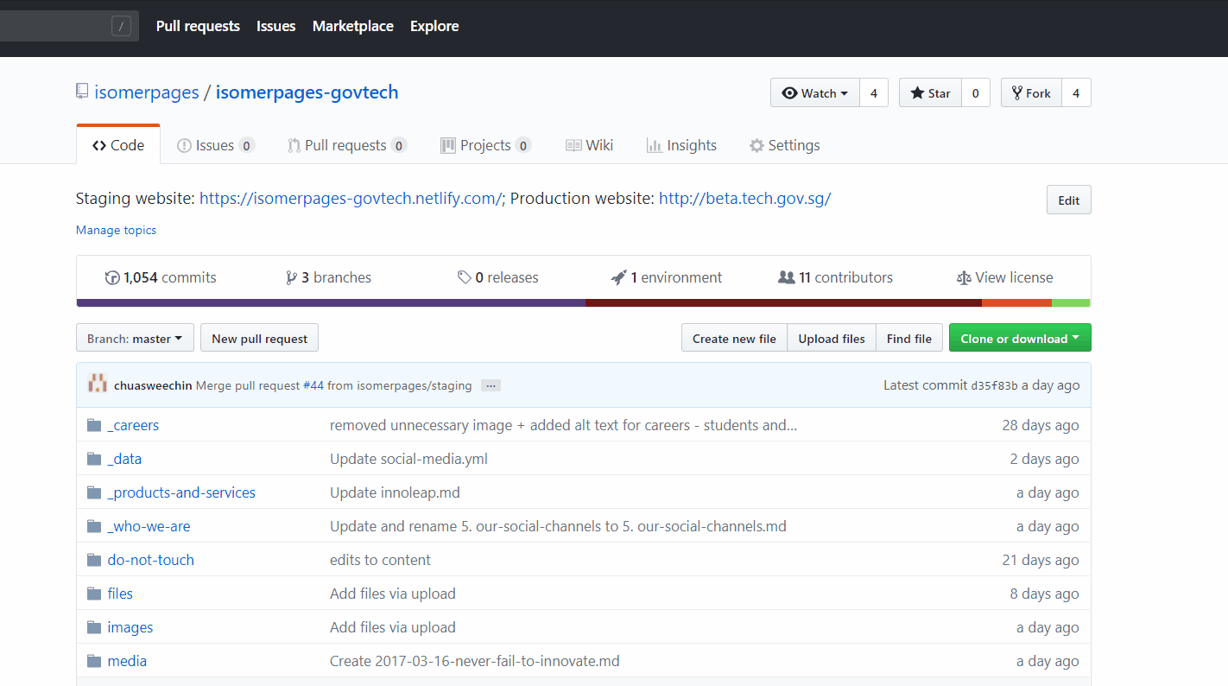
GovTech Example (Animation)

Slide 13
Add a new sub-page
1. Inside the selected folder, click on ‘Create new file’.
Make sure to set to ‘Staging’ branch first
e.g. To create a new subpage under ‘About’, click on the ‘Create new file’ button at the top right hand corner of the ‘_about’ directory

Slide 14
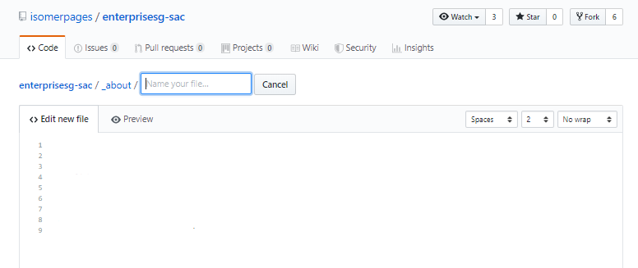
Add a new sub-page
1. Inside the selected folder, click on ‘Create new file’.
Check that you are editing inside the ‘_about’ directory

Slide 15
Add a new sub-page
2. Copy and paste the header code snippet below (or copy from other files inside the folder) into the top of the Github text editor. Edit the title, permalink and collection_name.
---
layout: leftnav-page-content
title: Fill in your own title description
permalink: /directory-name/fill-in-your-own-title-description/
collection_name: Same name as the preset collection name in _config.yml. You may get this from other pages in the same folder
---

Slide 16
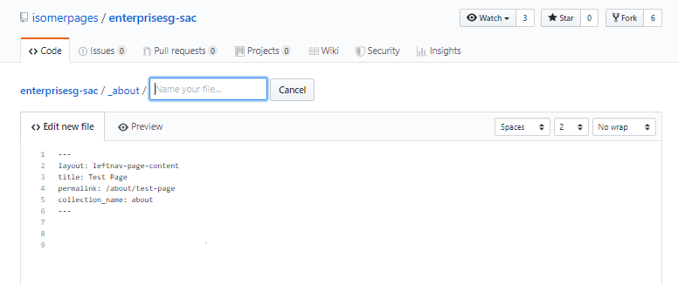
Add a new sub-page
2. Copy and paste the header code snippet below (or copy from other files inside the folder) into the top of the Github text editor. Edit the title, permalink and collection_name.

Slide 17
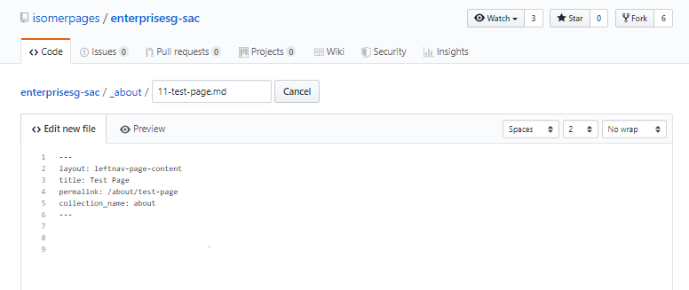
Add a new sub-page
3. Name the file in the format of N-filename.md or NN-filename.md
Note: Do not put spaces in the filename of your .md file. Always replace the spaces with dash (-).
Also remember to add the ‘.md’ extension at the end

Slide 18
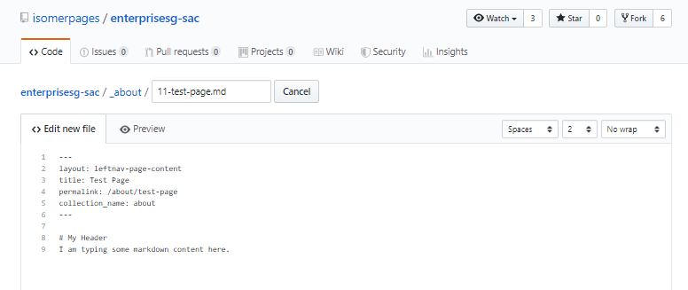
Add a new sub-page
4. Add in your markdown content of your page.
Add the markdown content below the header code

Slide 19
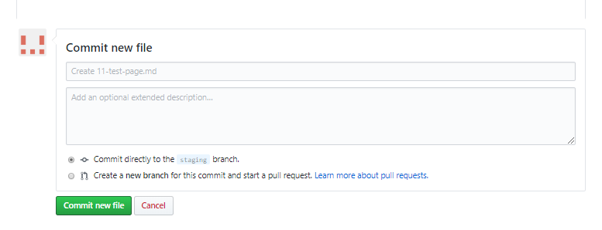
Add a new sub-page
5. Click on “Commit new file” button at the bottom of the text editor.

Slide 20
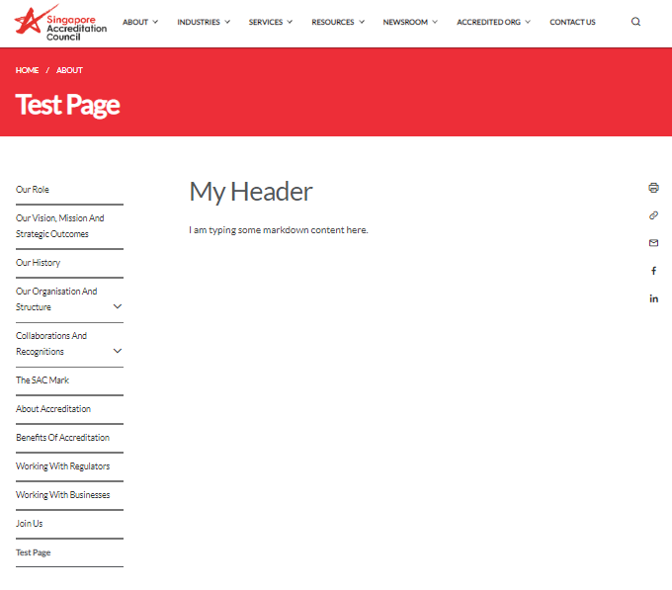
Adding inside Github Repository – Text editor
6. Wait a few minutes and refresh the SAC website to view the new page.

Slide 21
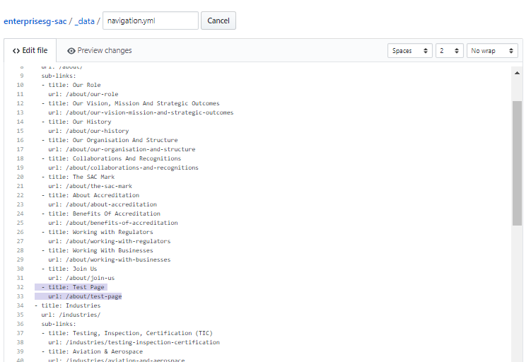
Editing inside Github Repository
7. To make the page appear in the dropdown menu under the main navigation bar, add the title and url in the relevant section in the ‘navigation.yml’ file inside the ‘_data’ folder. Click on ‘Commit Changes’ button when you are done.
# Sample Code Snippet
title: Test Page
url: /about/test-page

Slide 22
Editing inside Github Repository
7. To make the page appear in the dropdown menu under the main navigation bar, add the title and url in the relevant section in the ‘navigation.yml’ file inside the ‘_data’ folder. Click on ‘Commit Changes’ button when you are done.
Make sure that the title and the url is the same as the ‘title’ and ‘permalink’ in the header code of your new file
The indentation spacing in the navigation.yml file must be correct, otherwise the website may break.

Slide 23
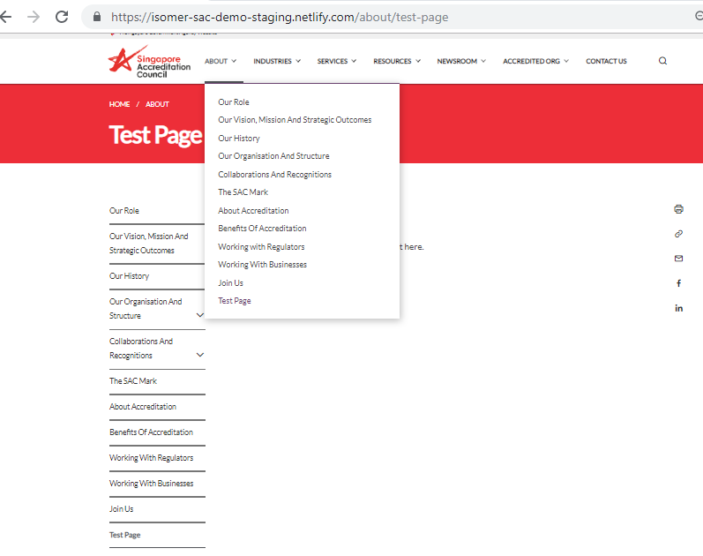
Editing inside Github Repository
7. To make the page appear in the dropdown menu under the main navigation bar, add the title and url in the relevant section in the ‘navigation.yml’ file inside the ‘_data’ folder. Click on ‘Commit Changes’ button when you are done.

Slide 24
Add a new sub-page – 3rd level navigation links
For 3rd level navigation links, the file will following the naming convention of [number][alphabet]-[filename].md (e.g. 11a-test-page.md, 1a-our-role.md).
We also add the parameter second_nav_title in the header code of the file.
---
layout: leftnav-page-content
title: International Membership
permalink: /about/international-membership
collection_name: about
Second_nav_title: “Collaborations and Recognition”
---
In this example, the header code tells isomer that this page belongs to the Github Repository second-level navigation named “Collaborations and Recognition” while the page title is “International Membership”.

Slide 25
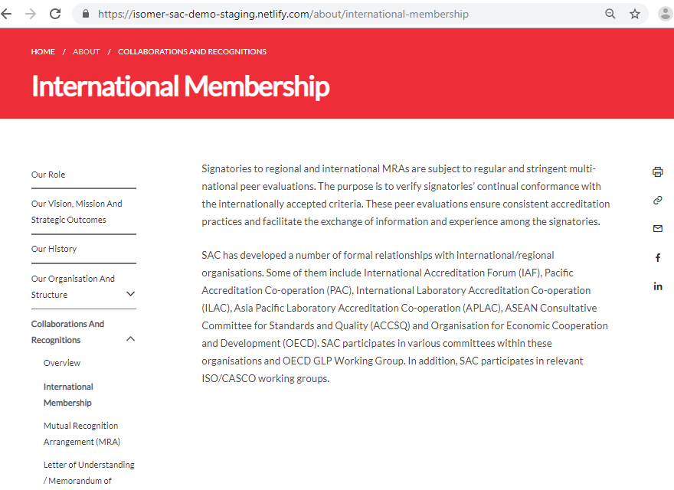
Add a new sub-page – 3rd level navigation links
Permalink
Breadcrumb
Page Title
2nd level navigation links
This page is grouped under the 2nd level navigation link “Collaborations and Recognitions”

Slide 26
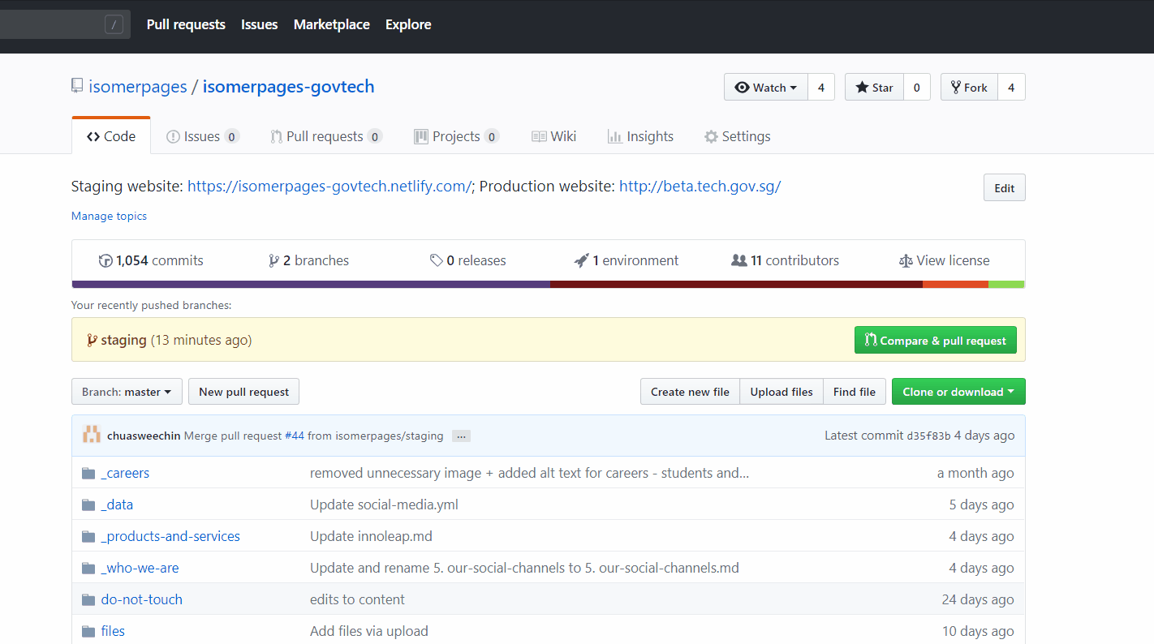
GovTech Example (Animation)

